Slide 1

The Yale Program on
Climate Change Communication
November, 2015
environment.yale.edu/climate

Slide 2
YPCCC
The Yale Program on Climate Change Communication is part of the Yale University’s School of Forestry & Environmental Studies. We:
Conduct research on public climate knowledge, risk perceptions, decision making, and behavior
Design and test new strategies to engage the public in climate science and solutions
Help educators and communicators with the knowledge and tools to more effectively engage their audiences

Slide 3
Why the Need?
Global Warming is an unusual threat, one that most people have difficulty processing as a clear and present danger:
The science seems confusing and has not been well explained
The idea can seem far-fetched
The impacts aren’t obvious on a personal level
It seems like a distant threat
There’s little an individual can do to protect him/herself
It doesn’t seem to be a settled scientific fact
Very partisan, wrong messengers

Slide 4
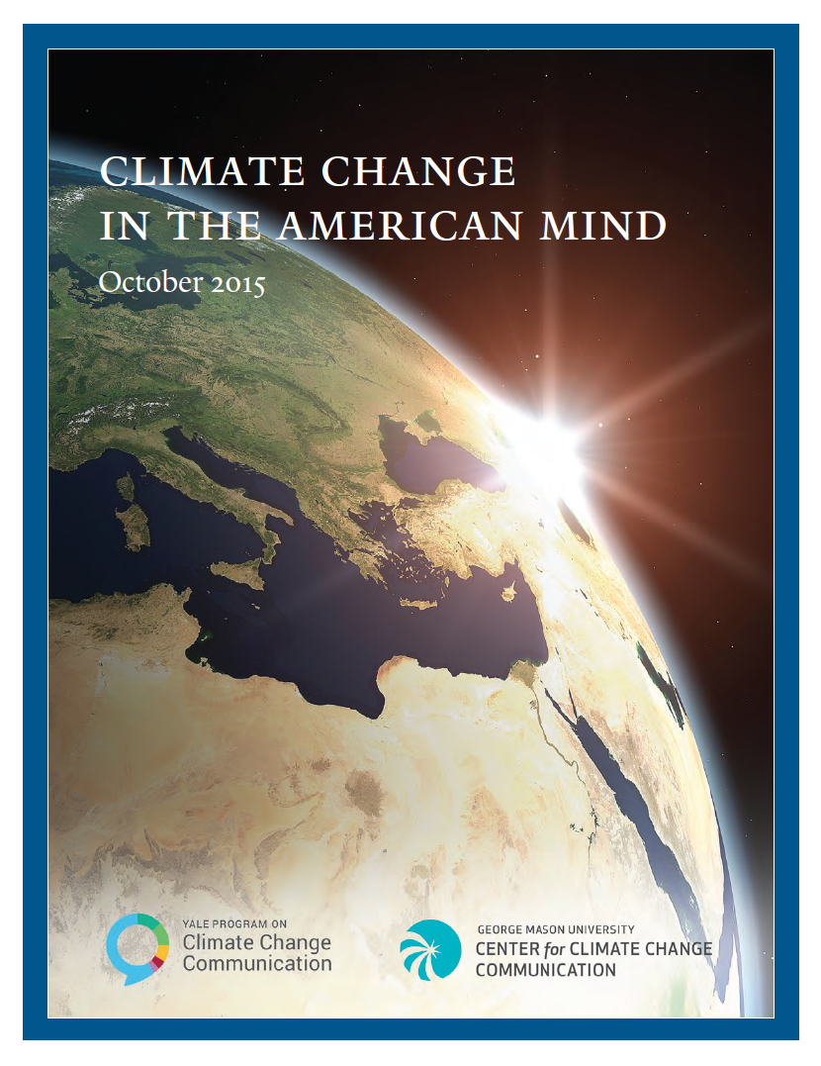
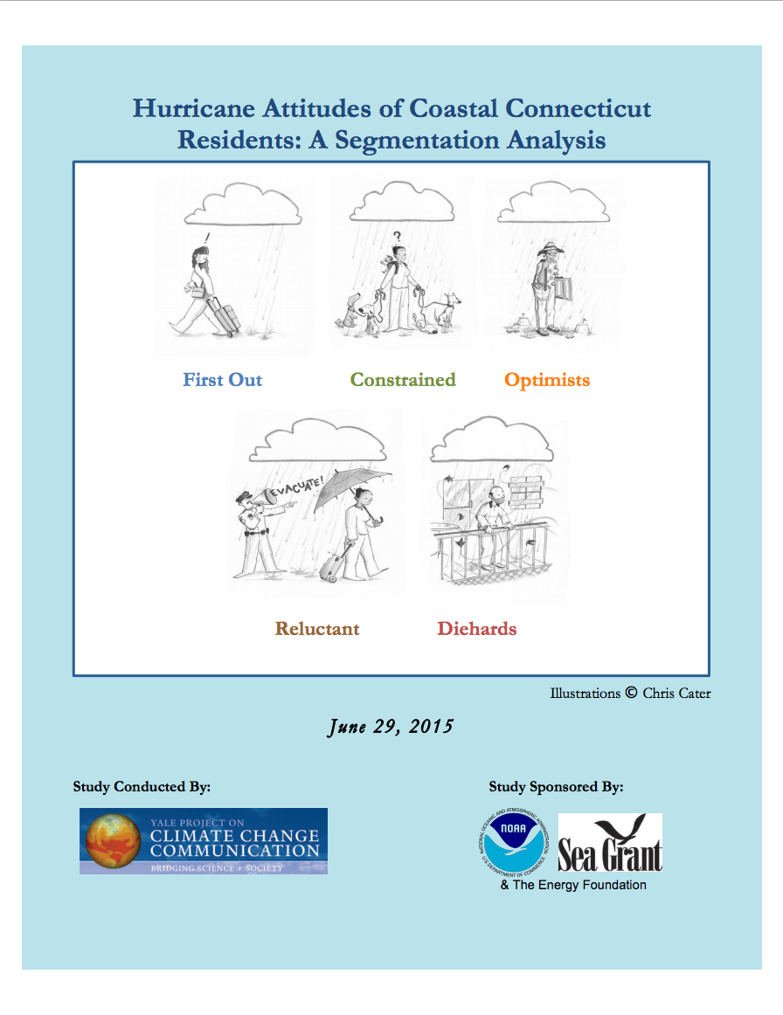
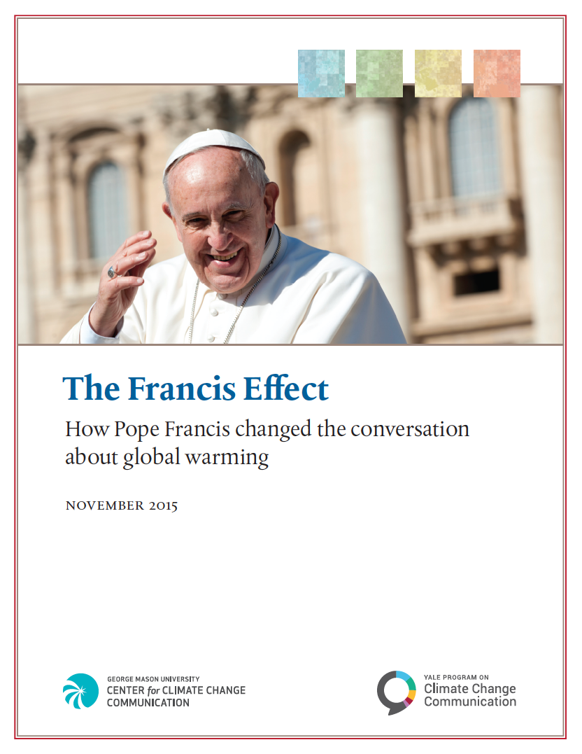
Public Opinion Research

Slide 5
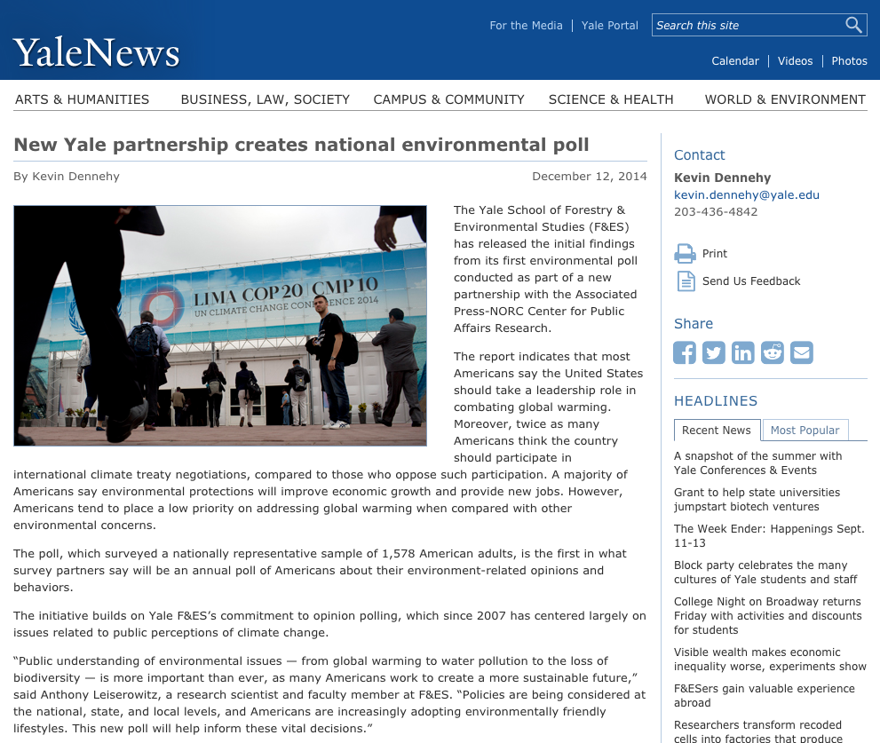
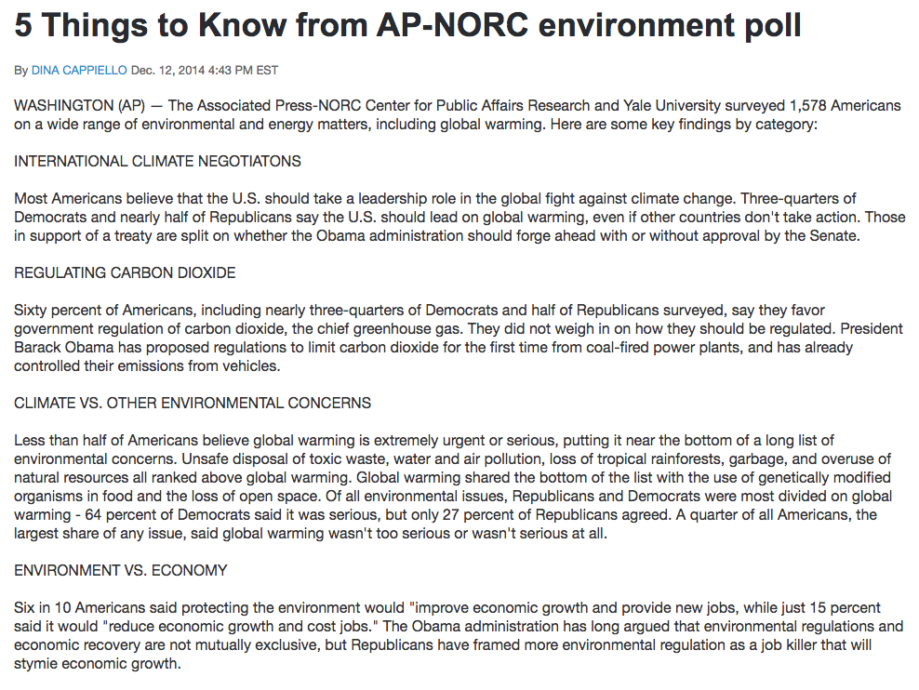
The Yale AP-NORC Environment Poll

Slide 6
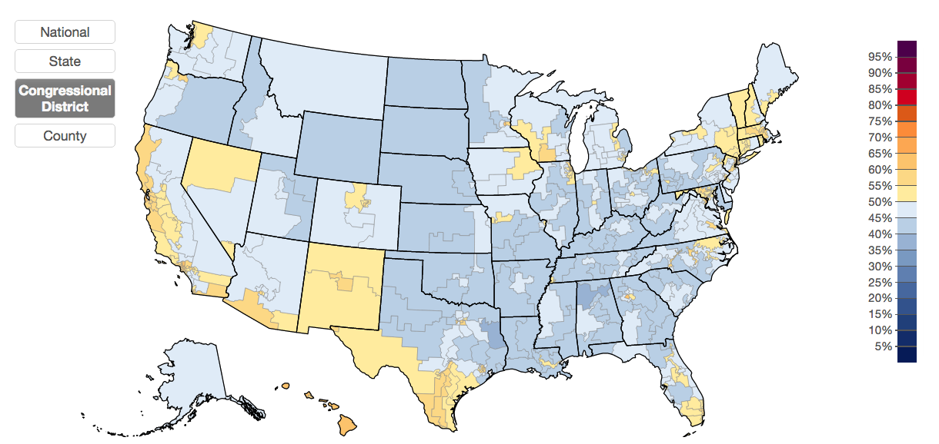
Yale Climate Opinion Maps (YCOM)
Estimated % of Americans who think global warming is mostly caused by human activities (by congressional district):

Slide 7
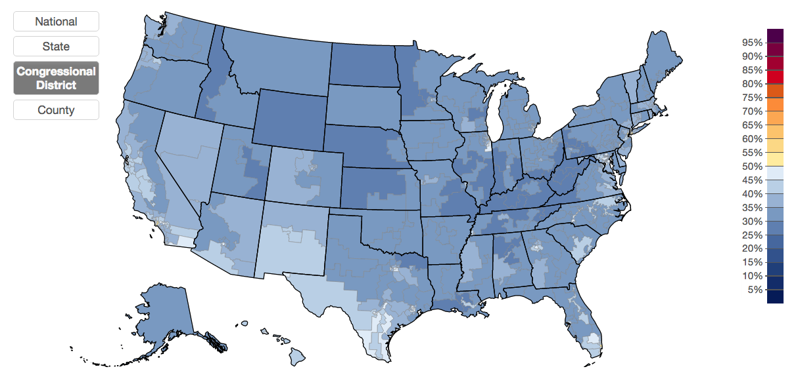
Yale Climate Opinion Maps (YCOM)
Estimated % of Americans who think global warming will harm them personally (by congressional district):

Slide 8
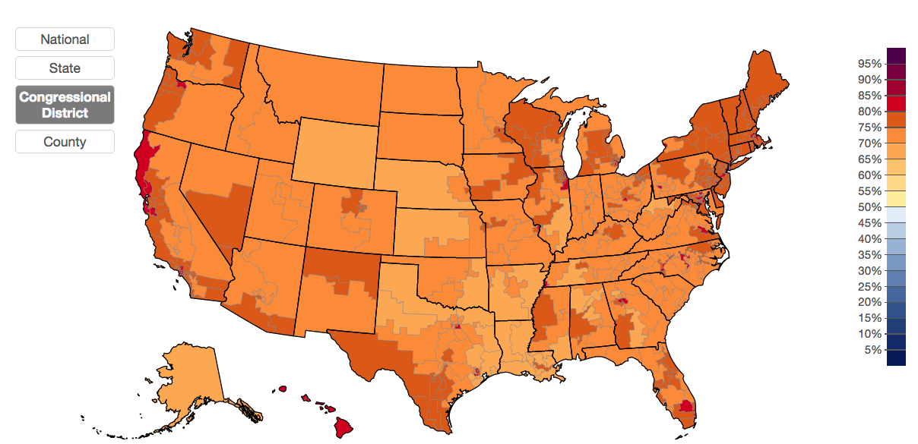
Yale Climate Opinion Maps (YCOM)
Estimated % of Americans who support regulating CO2 as a pollutant (by congressional district):

Slide 9
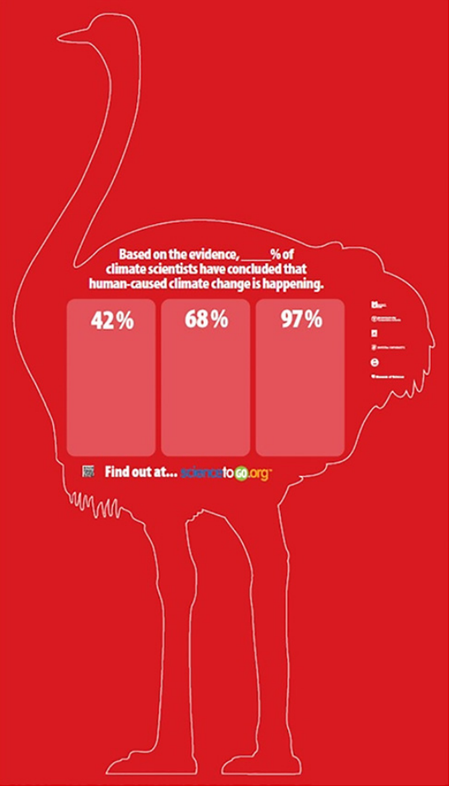
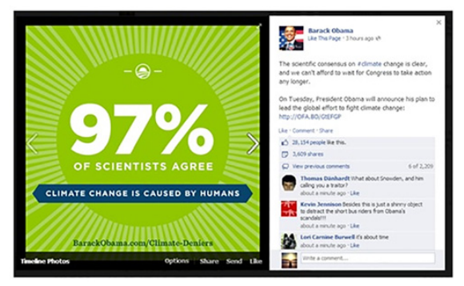
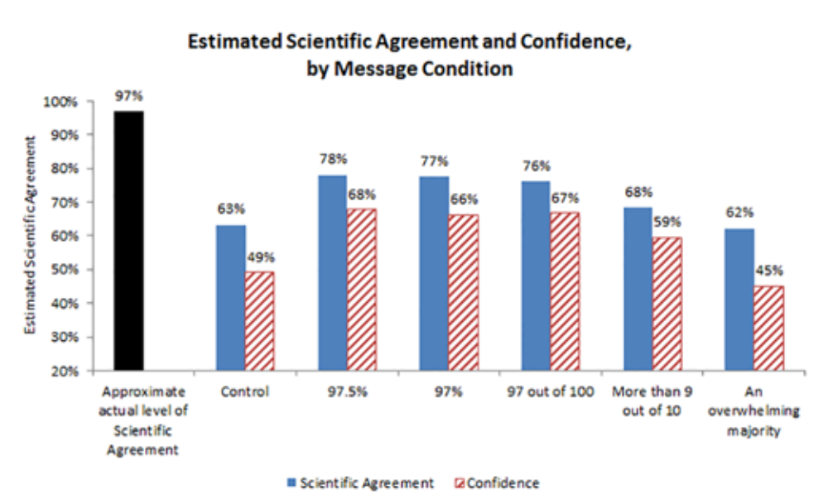
Message Testing

Slide 10
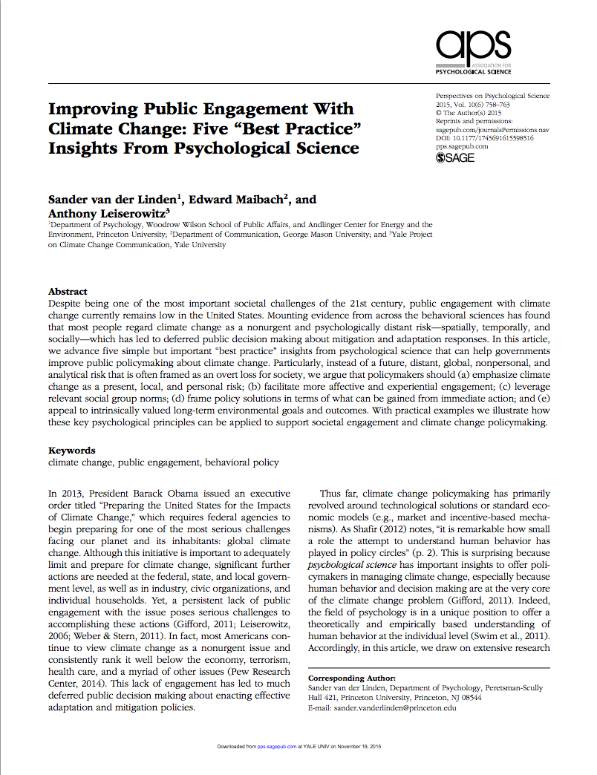
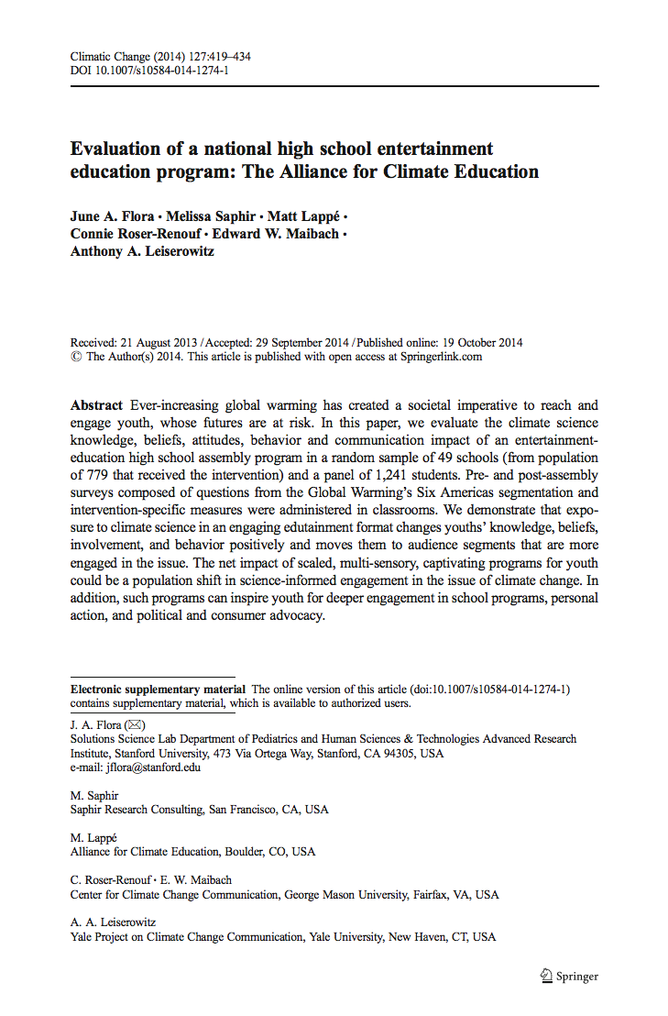
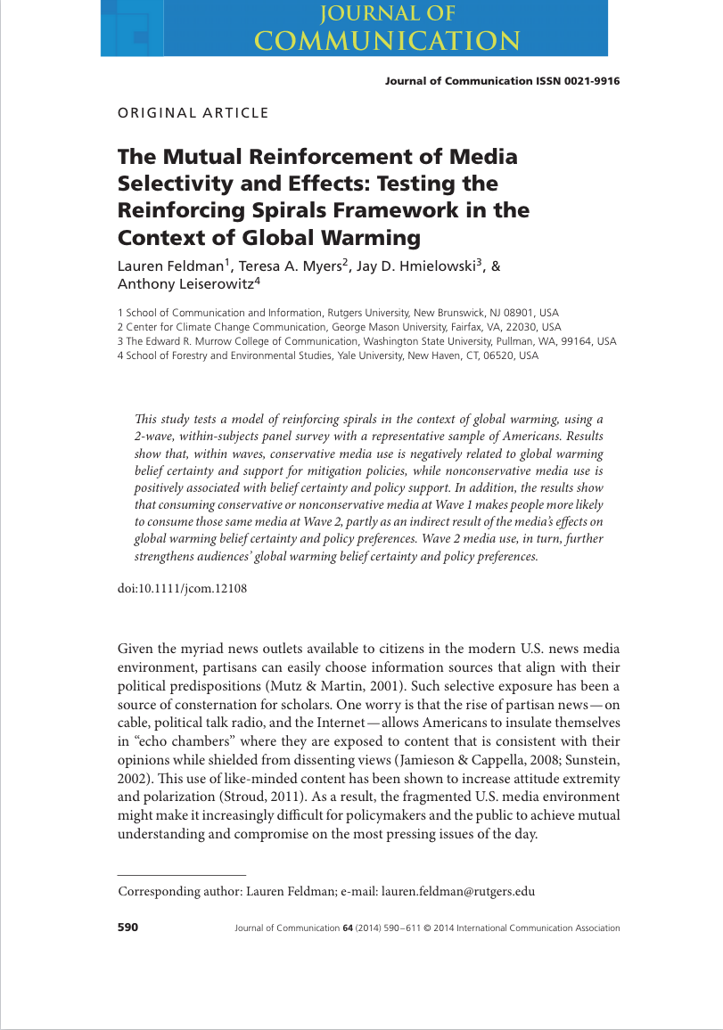
Peer-Reviewed Journal Articles

Slide 11
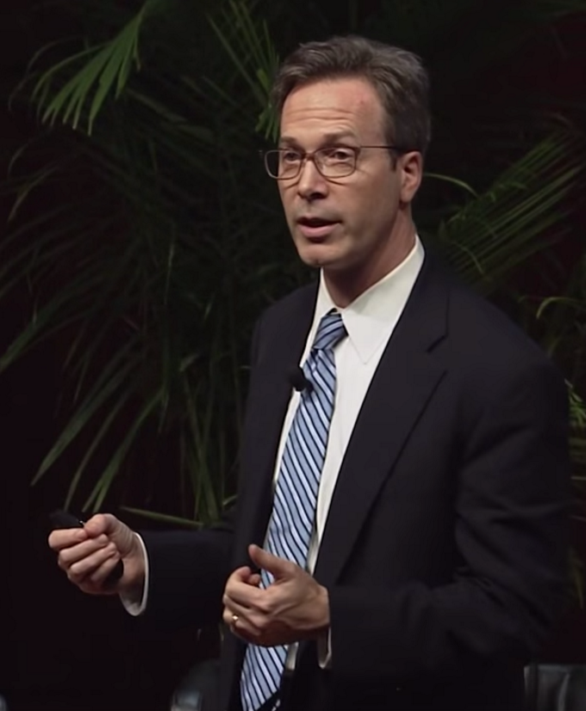
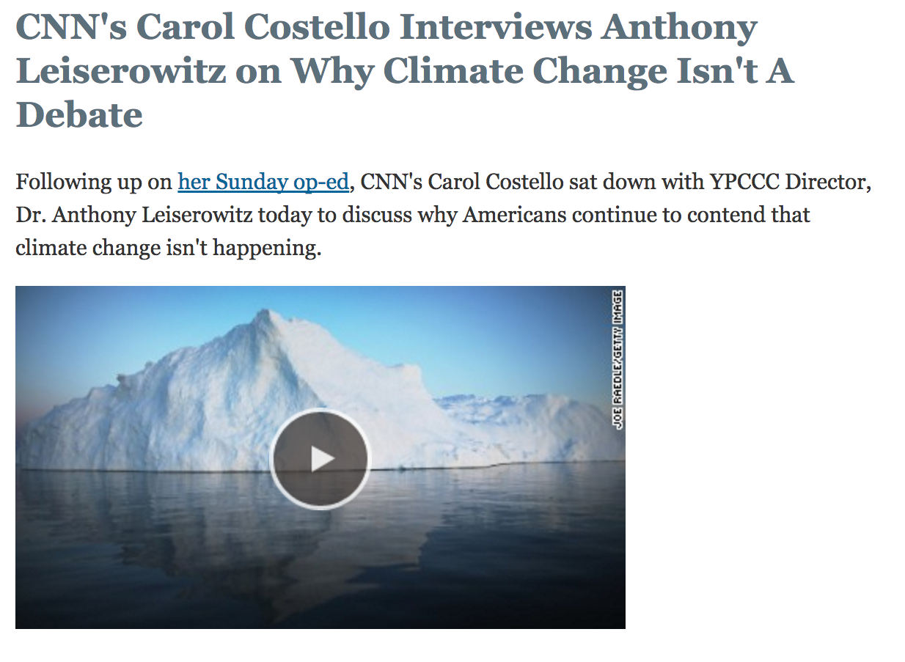
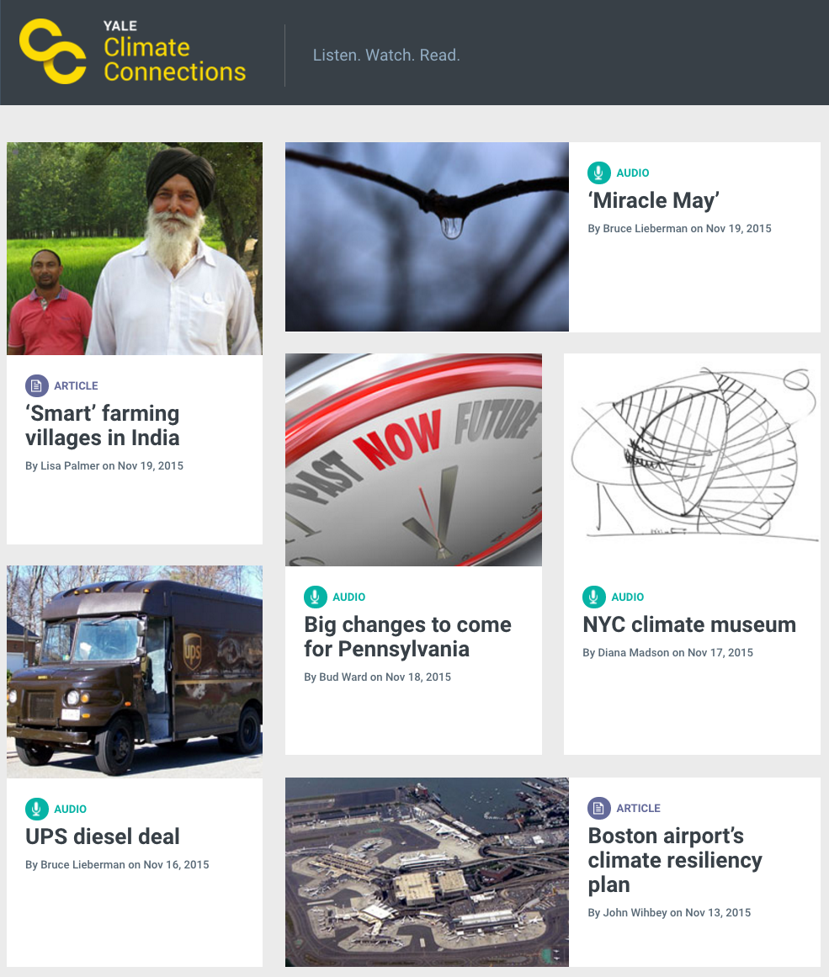
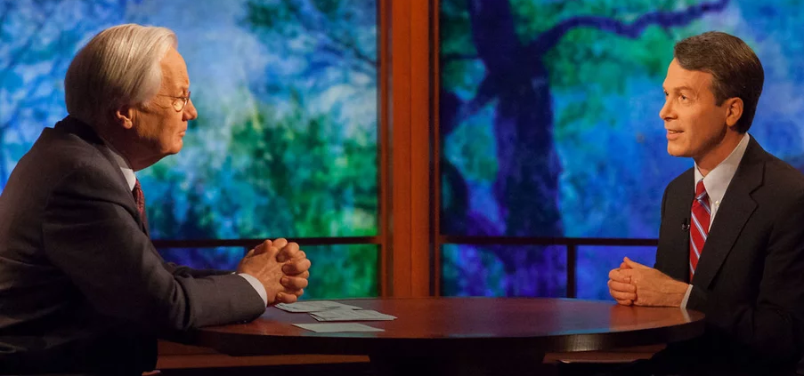
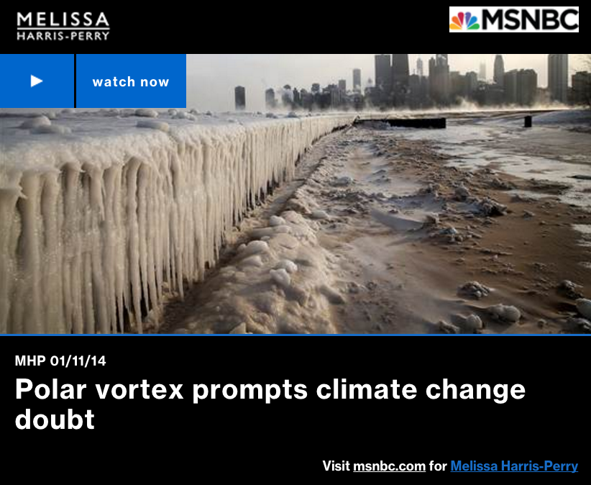
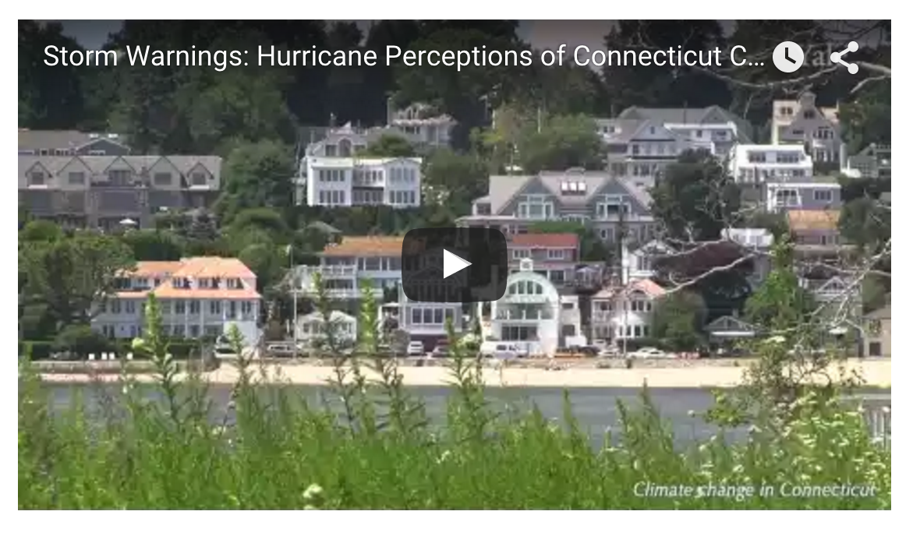
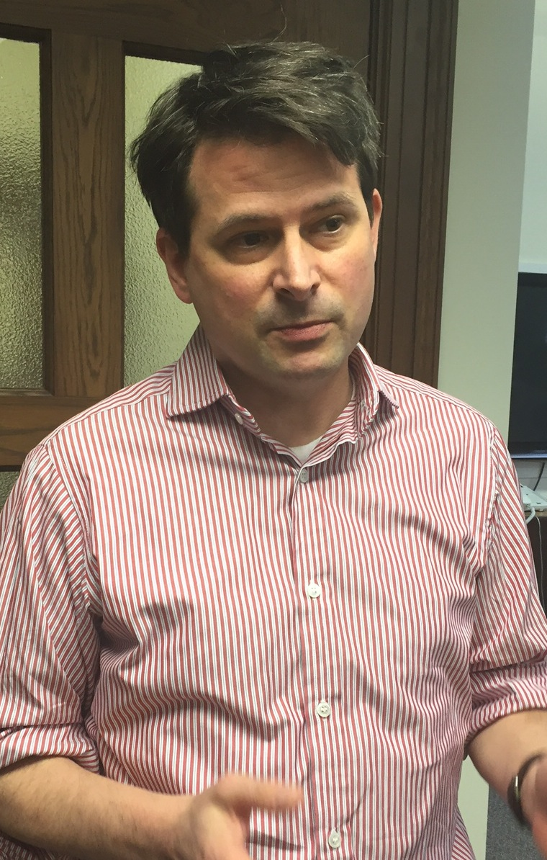
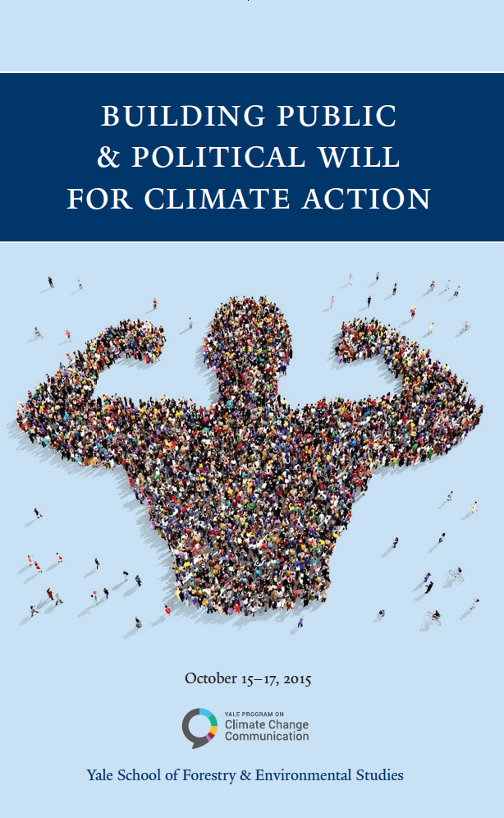
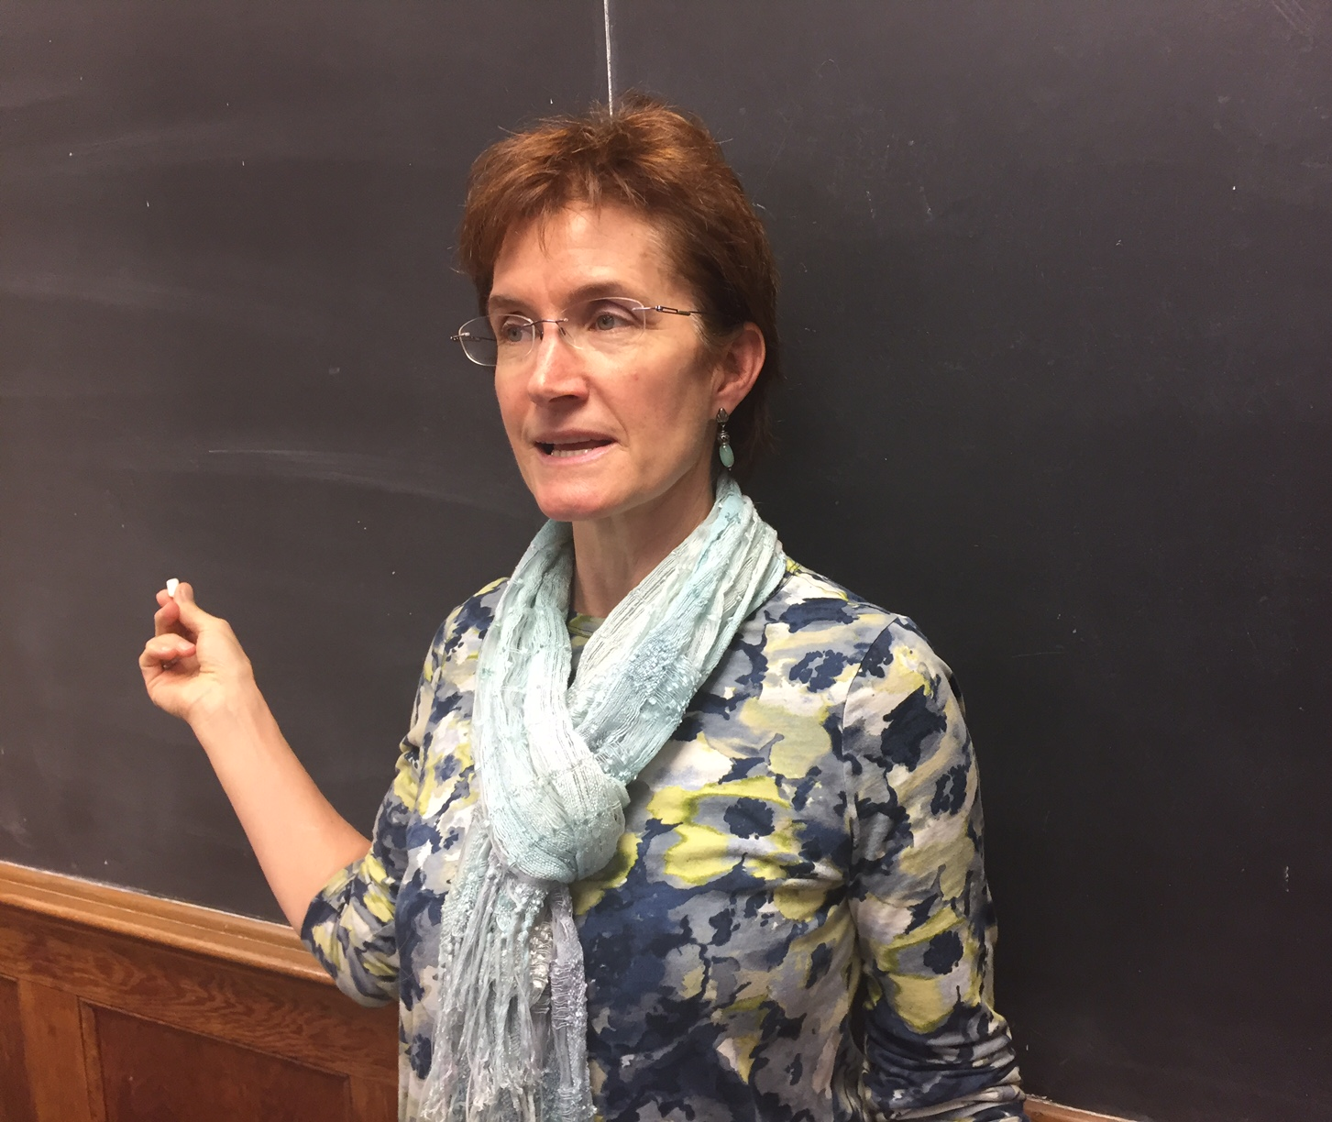
Public Outreach

Slide 12
The Yale Program on
Climate Change Communication
November, 2015
environment.yale.edu/climate

